Slide 1
Neural microcolumns as transmission lines: firing rate encoding analysis
Vincent Baker
Drexel University Department of Physics

Slide 2
Experiment
Peaks in the firing rate stimulate the base of a microcolumn ensemble, traveling waves carry the information to the top of the column
“Input” is the mean membrane potential of the base layer, “output” is the mean membrane potential of the top layer
Want to analyze quality of the encoded firing rate data

Slide 3
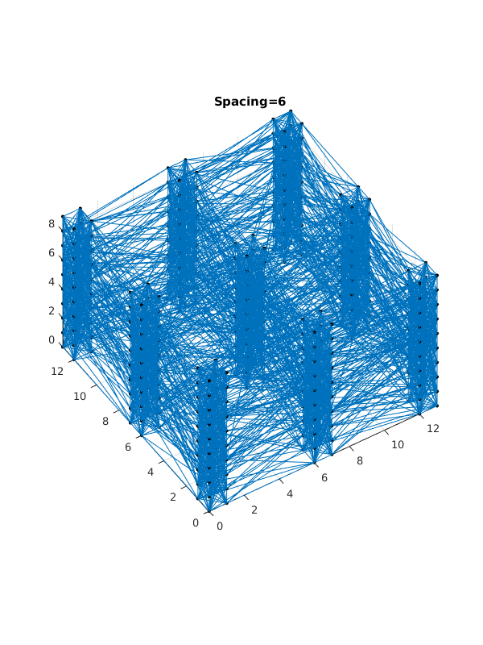
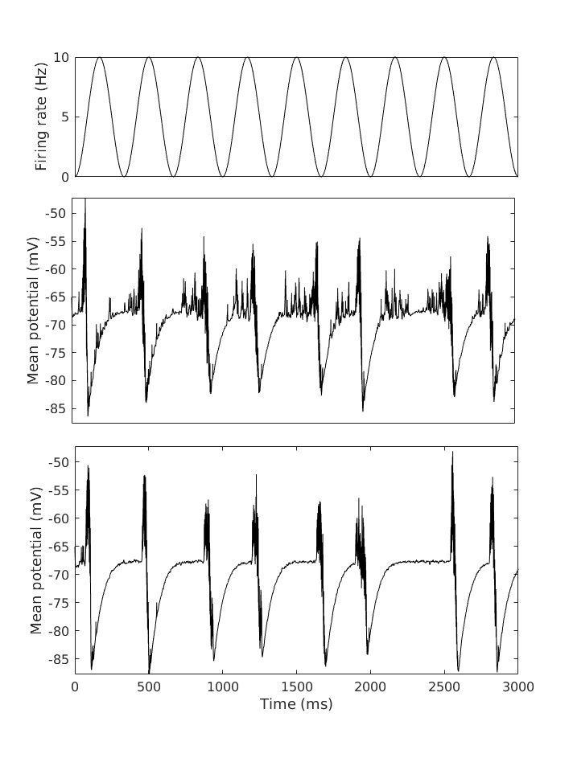
Experiment
Output from top layer of minicolumn ensemble
Firing rate
Ensemble of minicolumns (9 minicolumns, each 2x2 neurons wide)
Mean membrane potential of base layer
Mean membrane potential of top layer
Input to base layer of minicolumn ensemble
Pool of input neurons

Slide 4
Analysis method
Mean membrane potentials show typical spike patterns
Step 1: Trim refractory periods (< -68 mV resting potential)
Step 2: Add 68 mV to data to make it positive
Step 3: Filter with a 20 ms rectangular window to remove high frequency noise
Step 4: Find peaks using detection threshold of 10% of maximum value

Slide 5
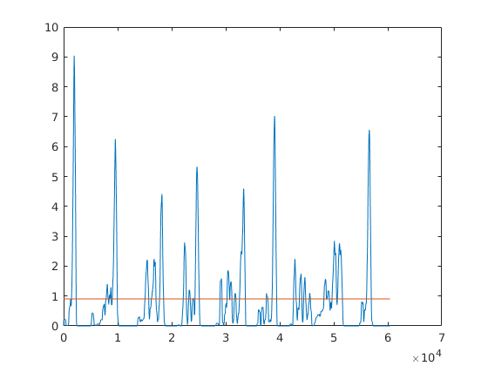
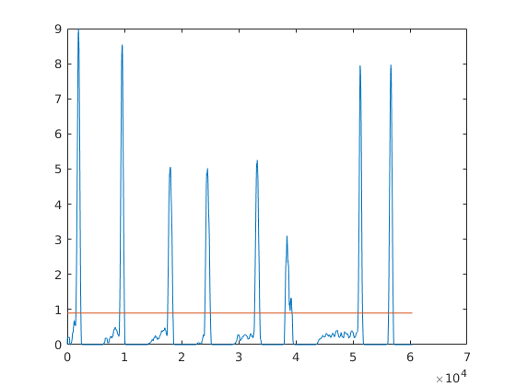
Example
Firing rate: 9 peaks
Output layer: 8 peaks
Threshold
Input layer: 27 peaks
Threshold

Slide 6
Possible figures of merit
# of detected peaks compared to # peaks in firing rate
Mean distance from detected peaks to nearest peaks in firing rate
Mean and standard deviation of detected peak duration

Slide 7
Notes
Illustrate with raster plot, NOT sine wave
How does traveling wave NARROW the peak? Plot width from raster plot
Single neuron experiment – after TAC
Abstract:
Opening: Different parts of the brain communicate via population firing rates
Scientific question: How can population firing rates be decoded by neural structures?
Need to compare to previous approaches (random collection?) “in the past people have…”
Why did we pick topology? “Here we test whether minicolumn ensemble can encode…”
Conclusions: “Minicolumn structure can effective encode…”
It’s a sharpening filter

